Slide 1
Data Engineering
Enterprise Data Management - Processes

Slide 2

Previous Day Recap
Duration - 2 minutes.
Interactive Discussion

Slide 3
Module Objectives
After completing this course you will be able to:
Classify Enterprise Data Management activities
Know when and how to use different data integration techniques
List the main phases involved in the design of a complex data management pipeline
Spot potential bottlenecks and know how to mitigate them
Define what constitutes data of high quality

Slide 4
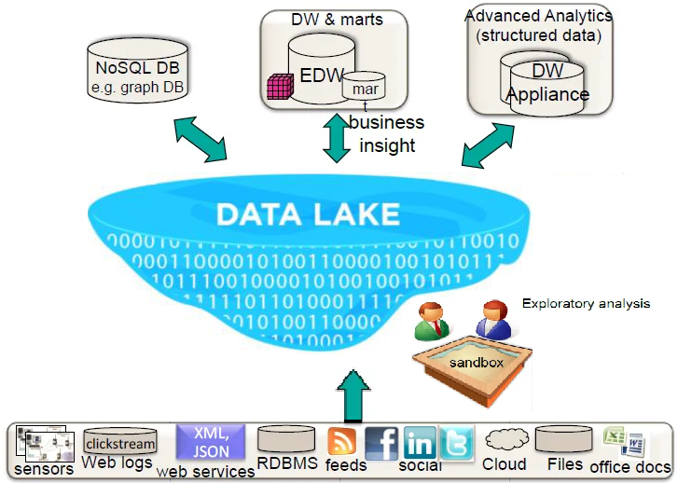
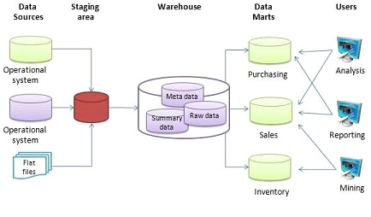
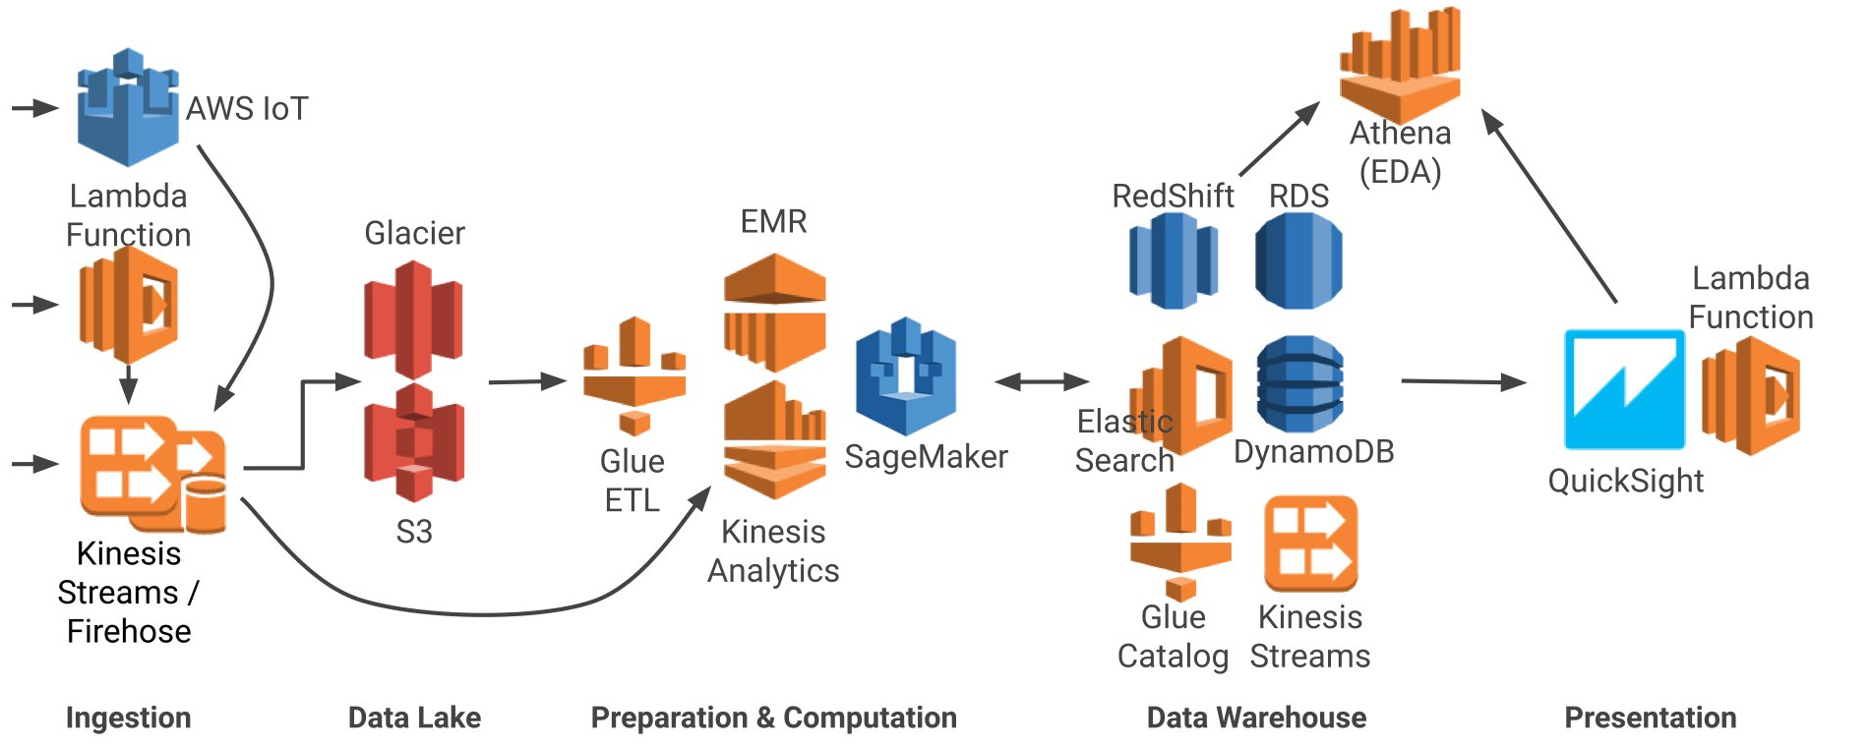
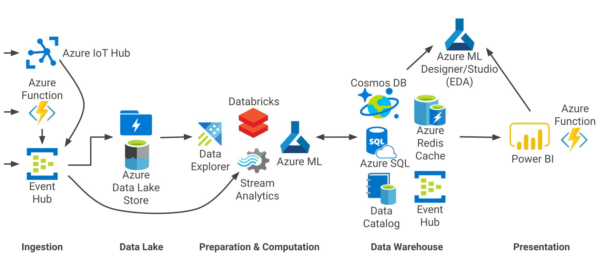
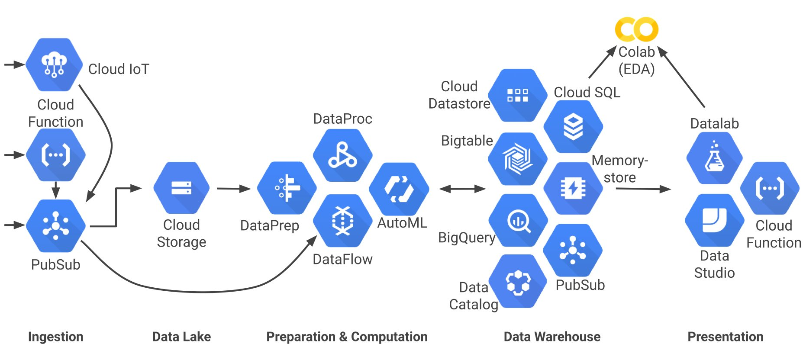
EDM Infrastructures: A Visual Recap
Let’s take another look at some common Enterprise Data Management solutions:

Slide 5
Management of the Enterprise’s Data
Looking at real-world EDM infrastructures, what do you notice?

Slide 6
Management of the Enterprise’s Data
Looking at real-world EDM infrastructures, what do you notice?
Data gets moved around a lot!

Slide 7
Management of the Enterprise’s Data
Looking at real-world EDM infrastructures, what do you notice?
Data gets moved around a lot!
To do that, tasks need to be implemented, jobs need to be run
clear procedures are needed to ensure each job manages the data correctly

Slide 8
Management of the Enterprise’s Data
Looking at real-world EDM infrastructures, what do you notice?
Data gets moved around a lot!
To do that, tasks need to be implemented, jobs need to be run
clear procedures are needed to ensure each job manages the data correctly
Some types of jobs need to be run repeatedly
data management procedures need to be automated

Slide 9
Data Migration vs. Data Integration
Two key types of Enterprise Data Management activities:
Data migration
a project designed to move data from one environment to another
Typically implemented over months or years, executed just once
At the end, the data is removed (or decommissioned) from the source
Data integration
a process to automate the flow of data between environments
It is used to combine data from one or more systems into one
It is a permanent part of the IT architecture
Notes:
Note that modern companies employ architecturally complex pipelines involving multiple activities. In these slides, we will be focusing on data integration activities.

Slide 10
Extract Transform & Load
Extract, transform & load (ETL) is a data integration procedure consisting of three phases:
Extract: the data is extracted from (possibly many, possibly heterogeneous) sources
Transform: the raw data is cleaned and converted into the desired format
Load: the cleaned data is added into the target storage system
Slow DB access and complex transformations are potential bottlenecks
Start each phase before the previous one has completed
Parallelize as much as possible
Use bulk unload/load whenever possible
If source data is frequently updated, ETL may not be ideal
Notes:
ETL is the “original” data integration activity. It originated in the 70’s and is very popular with DWHs. It remains popular with new technology as well, as it is used to move data to on-premise data lakes and even cloud architectures.

Slide 11
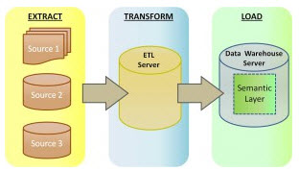
Extract Transform & Load
ETL consists of three phases:
Notes:
Source for diagram:
https://www.iri.com/blog/data-transformation2/etl-vs-elt-we-posit-you-judge/

Slide 12
Extract Load & Transform
Extract load & transform (ELT) is a variant of the ETL approach
The extracted data is loaded on the target system before going through the transform phase
This approach has gained popularity with highly-scalable cloud-based architectures
Pro’s:
Reduces loading time
Reduces data transfers
Provides full access to data
Con’s:
Requires highly-scalable processing power
Requires highly-scalable storage capacity
Increases the risk of creating data swamps
Notes:
ELT drastically reduces the time-to-load, as it removes several bottlenecks, such as moving data onto a staging area and performing pre-load transformations. It also decreases network traffic, since each data entry is moved at most once and then remains available. Finally, it enables end consumers to have the complete dataset at their disposal, as the data is copied in its original format.
On the other hand, it shifts computing power and storage demands from the network onto the target system. The target system (e.g. a data lake) must be powerful enough to process queries on-demand and apply the required transformation on the raw data, since the data is not processed on entry to the data lake. For the same reason, more data tends to be kept on the target system, potentially increasing the risk for unnecessary data duplication, which leads to the creation of data swamps.
For these reasons, ETL is more popular with smaller, more traditional architectures (more on the DWH side), whereas ELT is used in larger and more flexible architectures (moving towards the data lake and cloud-based side). Another factor to consider is legacy issues, since ETL has been around for longer and is optimized for the technology that many companies are still using (e.g. RDBMSs).
TEL (Transform, Extract, Load) is also possible. In this case, the data is transformed first, while still in the source system. Changes to the data can be recorded using a blockchain (e.g., token burning) before extracting and loading into another data store. This approach may not be feasible when several processing pipelines need to be applied to the same dataset, as it can quickly lead to unnecessary data replication.
Hybrid approaches like ETLT and TETLT are also being pursued. In the end, there is no silver bullet, it all depends on each system’s requirements.

Slide 13
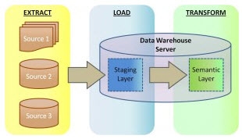
Extract Load & Transform
ELT performs the transformation on the target system:
Notes:
Source for diagram:
https://www.iri.com/blog/data-transformation2/etl-vs-elt-we-posit-you-judge/

Slide 14
Data Virtualization
Data Virtualization is a procedure that combines data from many sources without even moving it!
The consumer has a uniform view of the overall data, despite differences in format and location
Differences in semantics and format are resolved by an abstraction layer
Data updates that require write operations on the source are also supported
Pro’s:
Keeps physical storage system proliferation under control
Returns quick insights outside of major data projects
Reflects updates on the source in real-time
Con’s:
Takes longer to process queries
Performs poorly with high workloads
Does not replace ETL and DWH
Notes:
Data virtualization works best when used alongside other data integration processes such as ETL and ELT. If used properly, this approach can provide an alternative, unified perspective on data that resides on multiple heterogeneous source systems (including data warehouses, data marts and data lakes). This results in an increase in the availability and usage of enterprise data, without having to create a whole new integrated physical data platform. The existing data infrastructure continues to perform the core functions, while the data virtualization layer just leverages the data from those sources. It is ideal for sandbox environments, or to enable business users to access data they only need to access rarely. If queries become more frequent, a physical data mart can be added for better performance.
Data virtualization is also being used as an alternative for the ETL/DWH approach, to avoid the costs associated with the maintenance of that infrastructure and pipeline. However, it is not scalable and it gets less and less efficient as the workload increases.
Companies are called to strike a balance between agile infrastructure and optimal query performance. In the process, they have to consider the multiplicity of use cases (e.g., streaming, in-memory, hybrid storage). The right mix of data virtualization, integration, and storage strategies will come from a careful analysis of historical data storage requirements and a deep understanding of current and future trends.

Slide 15
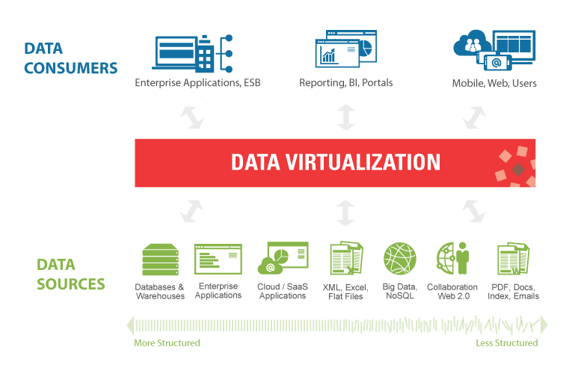
Data Virtualization
Data virtualization abstracts the data away from its physical location:
Notes:
Source for diagram:
https://www.denodo.com/sites/default/files/public/images/dv_architecture_design-time_simplified_0.png

Slide 16
Data Profiling
The choice of a data integration solution starts from profiling the data in the source systems:
Spot anomalies and assess data quality
Discover and assess enterprise metadata
Determine suitability of candidate source systems
While data profiling a system, we must consider and record:
Any available specification of the system and/or the data
Any relevant information, including:
gaps, typos, inconsistencies, …

Slide 17
Schema Definition
Having assessed the sources, we now turn to the target!
The next step is to specify the schema of the data and metadata in the target system
The name, format and meaning of each table and field must be annotated
The reference data must be defined
The transform rules must also be provided
The specification must abide by data governance rules, ensuring:
accuracy, consistency, availability, usability and security
Communication with all stakeholders may be required
especially end-users with direct access to the target system
for example, if the target system is a data mart
Notes:
Reference data is data that is used to classify or categorize other data. Examples include units of measurement, country codes, corporate codes, fixed conversion rates (e.g. weight, temperature and length), calendar structure and constraints:
https://en.wikipedia.org/wiki/Reference_data

Slide 18
Downloading and Uploading
Extracting data from and loading data to a storage system can result in bottlenecks
This is the case when source data is structured and transfers are fast
for example in closely connected DWH architectures
Ways to limit the impact include:
maximizing parallelism (pipelining, fine-tuning partitions of data and tasks, …)
minimizing data access frequency (bulk reads and loads)
Another challenge is scalability
Data volumes can quickly rise exponentially
Correctly anticipating future volumes is key
Notes:
NOTE: methods to overcome the bottlenecks vary widely, due to the variety of source systems and data formats.

Slide 19
Data Validation
Data validation checks that the data conforms to the expected schema and is of good quality
The data goes through a sequence of validation rules, which can be classified as:
Data type validation
Range and constraint validation
Code and Cross-reference validation
Structure validation
Consistency validation
The rules must ensure correctness, meaningfulness and security
Validation is applied at multiple stages in the integration process
Notes:
As mentioned above, data validation is applied at multiple stages in the data integration process. This is because each time the data is transferred or transformed, its values may be affected. Therefore, the data needs to be validated immediately after extract and (assuming we are following the ETL procedure), the data is validated again after transform and finally after load.
If the data fails the validation rules, it is rejected entirely or in part. The rejected data is ideally reported back to the source system for further analysis to identify and to rectify the incorrect records.
EXAMPLE of data validation:
An example of data type validation is to check that the value in a given field is an integer. A range and constraint validation on the same value is to check that it is between 1 and 200. A cross-reference validation will then check that it matches the country code, for the country value provided in a separate field. A consistency validation will then check that the item (also provided in a separate field) is sold in that country. Structure validation checks are typically more complex conditional rules that involve the whole record.
https://en.wikipedia.org/wiki/Data_validation

Slide 20
Data Preparation
During the transform phase, the raw data is mapped into the predefined format
The transformations may apply to values, records, fields, entities, …
Typical transformations include:
parsing, cleaning, filtering, standardizing, augmenting, tagging, joining, …
The purpose is to prepare the data for whichever use is required, such as:
Storage in some central repository (DWH, data lake or cloud)
Staging for further processing
Visualization and report creation
Advanced analytics
Machine learning model training

Slide 21
Data Cleansing
Data cleansing is the process of obtaining high quality data from possibly dirty or coarse data
High quality data is defined by the following criteria:
Validity
It satisfies constraints (data type/range, uniqueness, FK, reg. exp. patterns, …)
Accuracy
Does it conform to true value? (true value may be unknown)
Completeness
Almost impossible to fix (unless going back to the source)
Consistency
Distinct data items do not contradict each other
Uniformity
Same unit of measure used across systems
Notes:
When data is corrected (but not removed), we can speak of data editing:
https://en.wikipedia.org/wiki/Data_editing

Slide 22
Data Cleansing – How It Works
The data cleansing process may be split up into three separate steps:
Data auditing
It uses statistical methods
It gives an indication of the presence of anomalies, their type and location
Correction
Multiple anomalies require a workflow specification - techniques include:
Removing incorrect/duplicate entries;
Replacing incorrect / missing values with default / mean / median / …
Post-processing
Inspect results to check for correctness

Slide 23
Exercise 1
Research different data cleaning techniques
Duration - 15 minutes.
Discussion & Feedback.

Slide 24
Data Selection
Data entry removal may be required not just for cleaning purposes
Data needs to be carefully selected to provide a faithful representation of the overall population
Selection bias occurs when a particular group is either over- or under-represented
Data reduction is a special case of data selection
The aim is to reduce the size without losing information
Many algorithms are available
A use case is data reduction in the Kepler satellite
Data is orders of magnitude greater than downlink bandwidth
First, only meaningful parts of an image are selected
Then data reduction algorithms are applied
Wearable devices may also apply data reduction algorithms

Slide 25
Feature Selection
Wide tables have up to hundreds of thousands of attributes (features), thus being intractable
Feature selection aims to reduce data dimensionality by discarding features which are either:
Irrelevant for the purposes of the analysis, or
Redundant (i.e. highly correlated to some other feature)
Benefits include:
Model simplification, for easier interpretation of the results
Faster training
Avoiding the curse of dimensionality, namely:
Data points becoming sparse and dissimilar as dimensions increase
Data required to maintain density increases exponentially
May cause overfitting, or even make analysis impractical
Notes:
Feature selection is a common technique when the data is prepared for machine learning applications.

Slide 26
Module Review
What is the difference between data migration and data integration?
When are each of ETL / ELT / data virtualization best suited?
What is the purpose of data profiling?
What should we consider when defining the schema for the target system?
When should data validation be applied?
Why is data reduction important?

Slide 27
Questions

